Slide 1

Nomadic Octopus ID: G0133

Slide 2
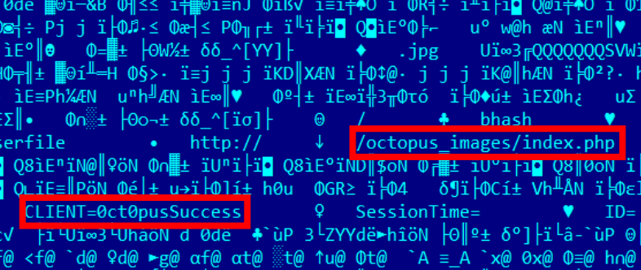
Who They Are?
Nomadic Octopus is a Russian-speaking cyber espionage threat group discovered or detected in 2015 and has been observed conducting campaigns involving android and windows malware, mainly using the “Delphi” programming language and building custom variants .

Slide 3

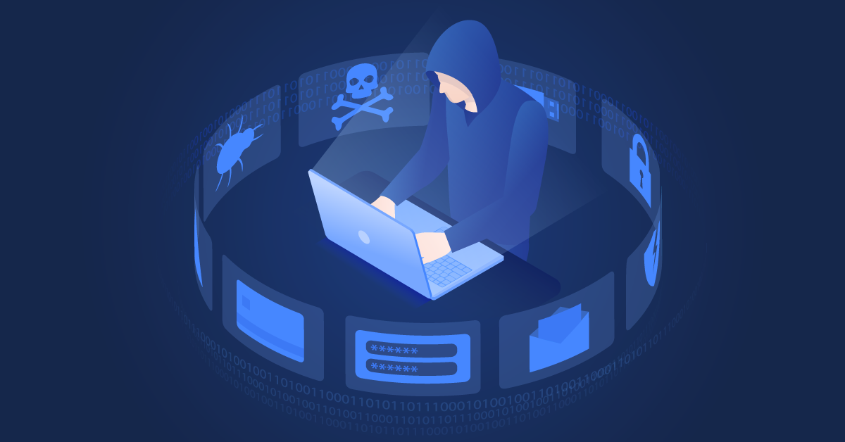
Cyber Espionage
Cyber espionage is a type of cyber attack that involves the unauthorized access, theft, or exploitation of sensitive information through digital means. It can be carried out by various actors, including state-sponsored groups, criminal organizations, and individuals with specialized skills.
To protect against cyber espionage, it is important to have strong cybersecurity measures in place, such as firewalls, encryption, and multi-factor authentication, as well as regular cybersecurity training.

Slide 4

Goal or Targets
The main goal of Nomadic Octopus appears to be cyber espionage against high-value targets, including diplomatic missions in the region. However, besides these high-value targets, we have seen a campaign targeting a local political blogger, which may suggest that Nomadic Octopus also conducts cyber surveillance operations.

Slide 5
How it happened?
Discovery: spearphishing email
Phishing is a type of cybersecurity attack in which malicious actors send messages impersonating trusted persons or organizations.
Instead of sending emails to thousands of people, this type focuses on individual employees at specific organizations that the attackers want to attack. These emails are often more personalized and customized to give the illusion that the sender and the victim have a relationship.

Slide 6
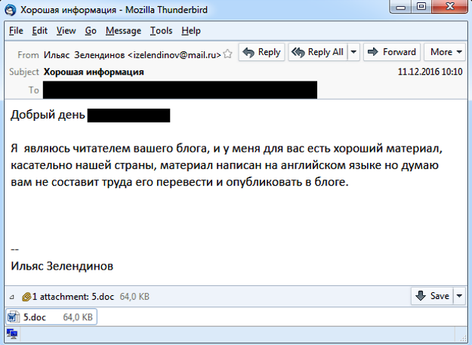
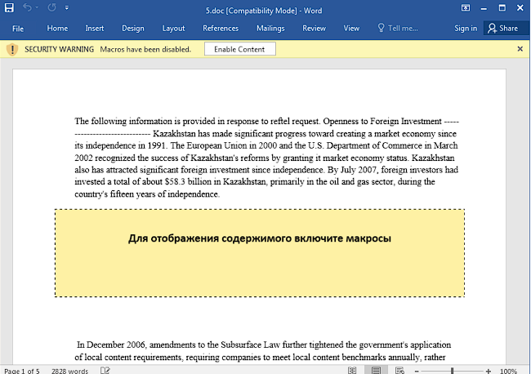
Discovery: Spearphishing email

Slide 7
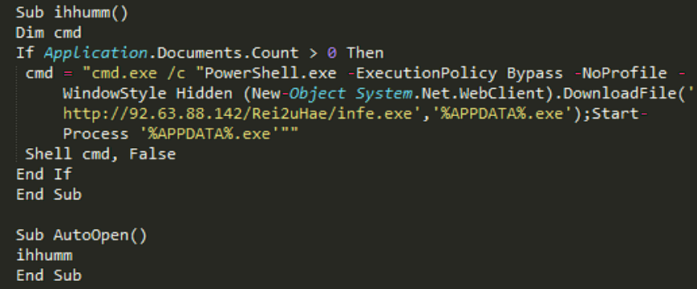
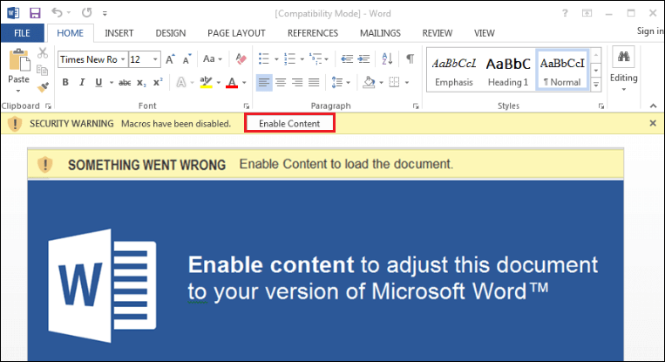
Malicious Macro
Macro malware hides in Microsoft Office files and is delivered as email attachments or inside ZIP files. These files use names that are intended to entice or scare people into opening them. They often look like invoices, receipts, legal documents, and more.

Slide 8
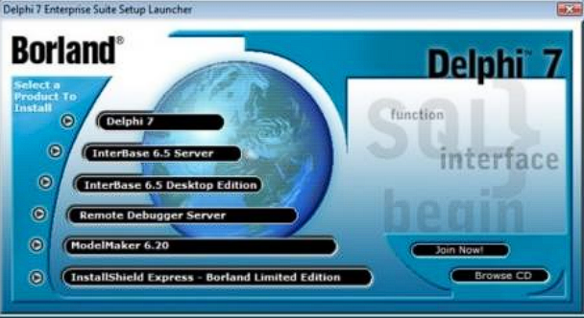

The malware: Delphi
Delphi is a general-purpose programming language and a software product that uses the Delphi dialect of the Object Pascal programming language and provides an integrated development environment (IDE) for rapid application development of desktop, mobile, web, and console software, currently developed and maintained by Embarcadero Technologies.

Slide 9
Techniques
Name | Use
Command and Scripting Interpreter: PowerShell | Nomadic Octopus has used PowerShell for execution
Hide Artifacts: Hidden Window | Nomadic Octopus executed PowerShell in a hidden window
Ingress Tool Transfer | Nomadic Octopus has used malicious macros to download additional files to the victim's machine.
Phishing: Spearphishing Attachment | has targeted victims with spearphishing emails containing malicious attachments
User Execution: Malicious File | Nomadic Octopus as attempted to lure victims into clicking on malicious attachments within spearphishing emails
Command and Scripting Interpreter: Windows Command Shell | Nomadic Octopus used cmd.exe /c within a malicious macro
Masquerading | Nomadic Octopus attempted to make Octopus appear as a Telegram Messenger with a Russian interface

Slide 10
Masquerading
Adversaries may attempt to manipulate features of their artifacts to make them appear legitimate or benign to users and/or security tools. Masquerading occurs when the name or location of an object, legitimate or malicious, is manipulated or abused for the sake of evading defenses and observation. This may include manipulating file metadata, tricking users into misidentifying the file type, and giving legitimate task or service names.
Procedure Examples:
AppleSeed:
AppleSeed can disguise JavaScript files as PDFs.
Bisonal:
Bisonal dropped a decoy payload with a .jpg extension that contained a malicious Visual Basic script.
Bisonal is a remote access tool (RAT) that has been used by Tonto Team against public and private sector organizations in Russia, South Korea, and Japan since at least December 2010.

Slide 11

Thank you

